Slide 1


DESIGN 1
Lesson 1: The Anatomy of an HTML Document
Ms. Abboud · Grade 9 - Design 1 · Term 1, Week 2

Slide 2
Learning Objectives
WALT - We Are Learning To
WILF - What I'm Looking For
Explain what each core structural tag does: <!DOCTYPE html>, <html>, <head>, <title>, and <body>.
Correctly use and nest these tags in the right order to build a valid HTML document.
Can name the 5 core structural tags in the correct order.
Can explain the difference between <head> and <body>.

Slide 3
Academic Vocabulary
Doctype Declaration
Head
The very first line of an HTML file (<!DOCTYPE html>) that tells the browser which version of HTML to expect.
The part of an HTML document (<head>) that holds information about the page, like its title, nothing inside it shows directly on the page.
Body
Nesting
The part of an HTML document (<body>) that holds everything visible to a visitor, text, images, links, etc.
Placing one HTML element inside another, so the inner element is fully contained within the outer one.

Slide 4
Frayer Model: Nesting
DEFINITION
CHARACTERISTICS
Placing one HTML element inside another, so the inner element is fully contained within the outer one.
One element fully inside another; inner tags close before outer tags.
NESTING
EXAMPLES
NON-EXAMPLES
<li> inside <ul>; <strong> inside <p>.
Two tags placed side-by-side, not inside one another.

Slide 5
National Identity Integration
UAE Digital Economy: every clearly structured webpage you build is a small-scale example of the digital infrastructure the UAE is investing in as it grows a knowledge-based economy. The same logical organization you practice today, breaking a page into head and body, nesting elements correctly, is exactly what powers the government services, banking apps, and businesses that make up the UAE's digital economy.

Slide 6
STARTER
Recap last week's file
Which tags did we use in our Hello World / About Me file, and what might be missing from a 'real' webpage?
Hook · Engage & Ask
5 - 10 minutes

Slide 7
LESSON CORE
I Do: Teacher Demo
Every HTML document needs a standard 'skeleton': DOCTYPE, html, head, and body.
Live demo: build the structure line by line, explaining what each tag does.
Gradual Release of Responsibility
30 - 40 minutes
Example: the basic HTML skeleton
<!DOCTYPE html>
<html>
<head>
<title>Page Title (shows in browser tab)</title>
</head>
<body>
<!-- Everything visible on the page goes here -->
</body>
</html>
1 / 3

Slide 8
LESSON CORE
We Do: Diagnose Together
Structuring a page means breaking one big problem into smaller, logical parts.
Diagnose this broken structure together: what's missing or out of order?
Gradual Release of Responsibility
30 - 40 minutes
Example: spot what's broken
<html>
<head>
<title>My Page
<body>
<h1>Welcome</h1>
</html>
2 / 3

Slide 9
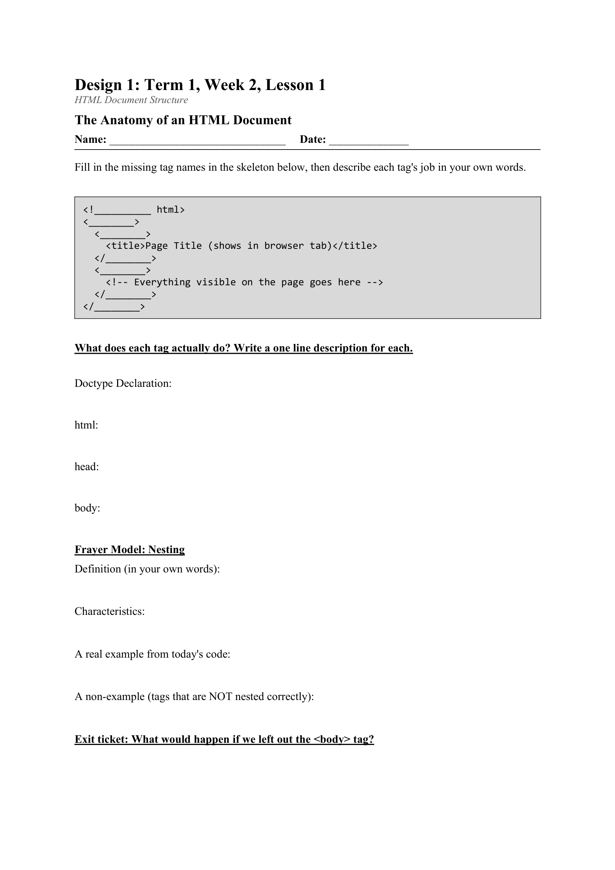
LESSON CORE
You Do: Label the Diagram
Label a given blank HTML structure diagram with the correct tag names and a one-line description of each tag's job.
Activity: HTML Structure Diagram, Labeling Worksheet
Gradual Release of Responsibility
30 - 40 minutes
3 / 3

Slide 10
CLOSURE
Exit ticket
What would happen if we left out the <body> tag?
Transition & Extend
5 - 10 minutes

